Slide 1
ASSIGNMENT WORK 02/04/2024
MAYUR ADHAYGE

Slide 2
ASSIGNMENT NO :- 01
Draw your Home Network Topology and explain how you are accessing the RPS Lab environment.

Slide 3
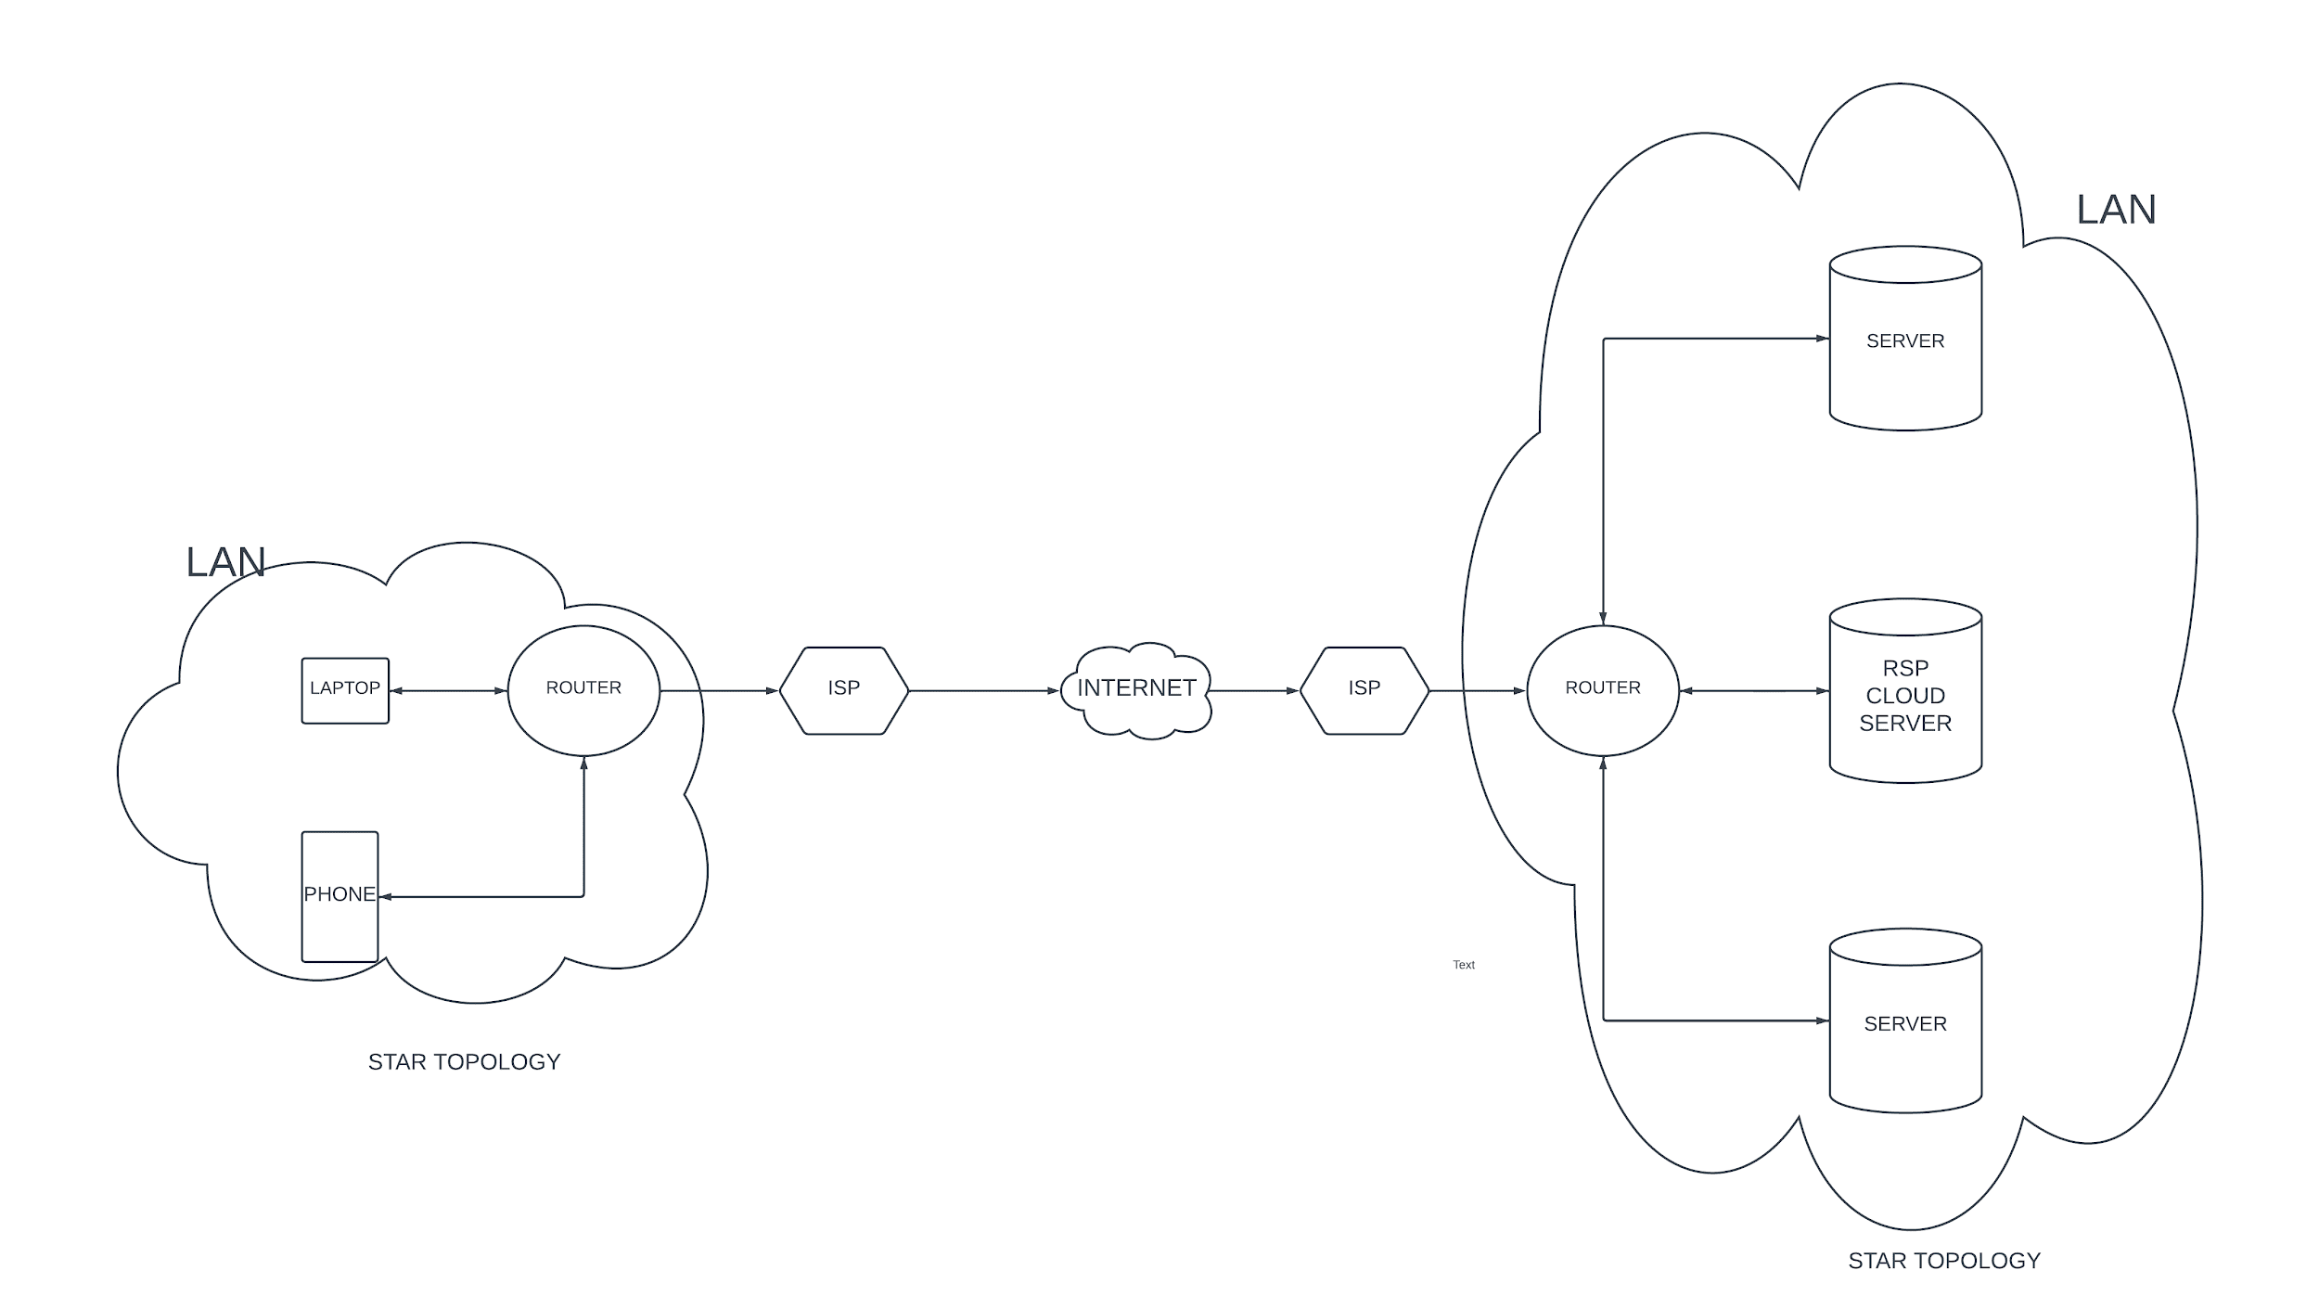
HOME CONNECTION TO RPS CLOUD SERVER TOPOLOGY DIAGRAM

Slide 4
ASSIGNMENT NO :- 02
Identify a real-world application for both parallel computing and networked systems. Explain how these technologies are used and why they are important in that context.

Slide 5
Real-World Applications of Parallel Computing and Networked Systems
MAYUR ADHYAGE
DATE:-02/04/2024

Slide 6
Introduction
Definition of Parallel Computing:
Parallel computing is a type of computation in which many calculations or processes are carried out simultaneously.
Definition of Networked Systems:
Networked systems refer to a group of interconnected computing devices or systems that can exchange data and resources.
Importance:
the significance of these technologies in modern computing, emphasizing their role in improving efficiency and connectivity.

Slide 7
Real-World Application 1:
Parallel Computing - AI Training Processing
Artificial Intelligence (AI) involves training machine learning models on large datasets to recognize patterns and make predictions.
Parallel computing techniques are used to distribute the computational workload across multiple processors or GPUs, accelerating the training process.
Importance:
Speeds up the development of AI applications, such as image recognition, natural language processing, and autonomous vehicles.
Enables researchers and developers to experiment with complex AI algorithms and models more efficiently.
Visual:Diagram illustrating parallel processing during AI model training, with multiple GPUs working concurrently to process data and update model parameters.

Slide 8
Real-World Application 2:
Networked Systems - Social Media
Social media platforms connect millions of users worldwide, allowing them to share content, communicate, and interact in real-time.
Networked systems facilitate data exchange, content delivery, and user engagement through interconnected servers and communication protocols.
Importance:
Enhances connectivity and collaboration among individuals, businesses, and communities.
Supports personalized content delivery, targeted advertising, and social networking features, driving user engagement and platform growth.
Visual: Schematic depicting the architecture of a social media network, including servers, databases, and user devices interconnected via the internet.

Slide 9
Importance of Parallel Computing
Why Parallel Computing Matters?
Accelerates complex computations and simulations, such as AI model training, scientific research, and financial analysis.
Enables faster processing of large datasets, leading to quicker insights and decision-making.
Improves efficiency in various domains, including data analysis, computer-aided design, and virtual reality.
Visual: the performance improvement achieved through parallel computing compared to sequential processing.

Slide 10
Importance of Networked Systems
Why Networked Systems Matter?
Facilitates communication and collaboration among users, enabling the exchange of information and resources.
Provides access to shared data and services, such as cloud storage, online applications, and streaming media.
Supports real-time data exchange and decision-making in industries such as finance, healthcare, and entertainment.
Visual: Illustration depicting various networked systems, including social media platforms, online marketplaces, and Internet of Things (IoT) devices.

Slide 11
Conclusion
Recap of the importance of parallel computing and networked systems in modern computing.
Emphasize their role in enhancing efficiency, connectivity, and innovation across various industries.
Encourage further exploration and adoption of these technologies to address evolving computational challenges and opportunities.

Slide 12
Thanking you !

